Slide 1
SARA: Past, Present, and Future
Higher Learning Commission
Chicago, IL
April 17, 2016

Slide 2
Presenters:
Jenny Parks
Director, M-SARA
Sandra Doran
Director, N-SARA
Mary A. Larson
Director, S-SARA
John Lopez
Director, W-SARA

Slide 3
The Current SARA Landscape

Slide 4
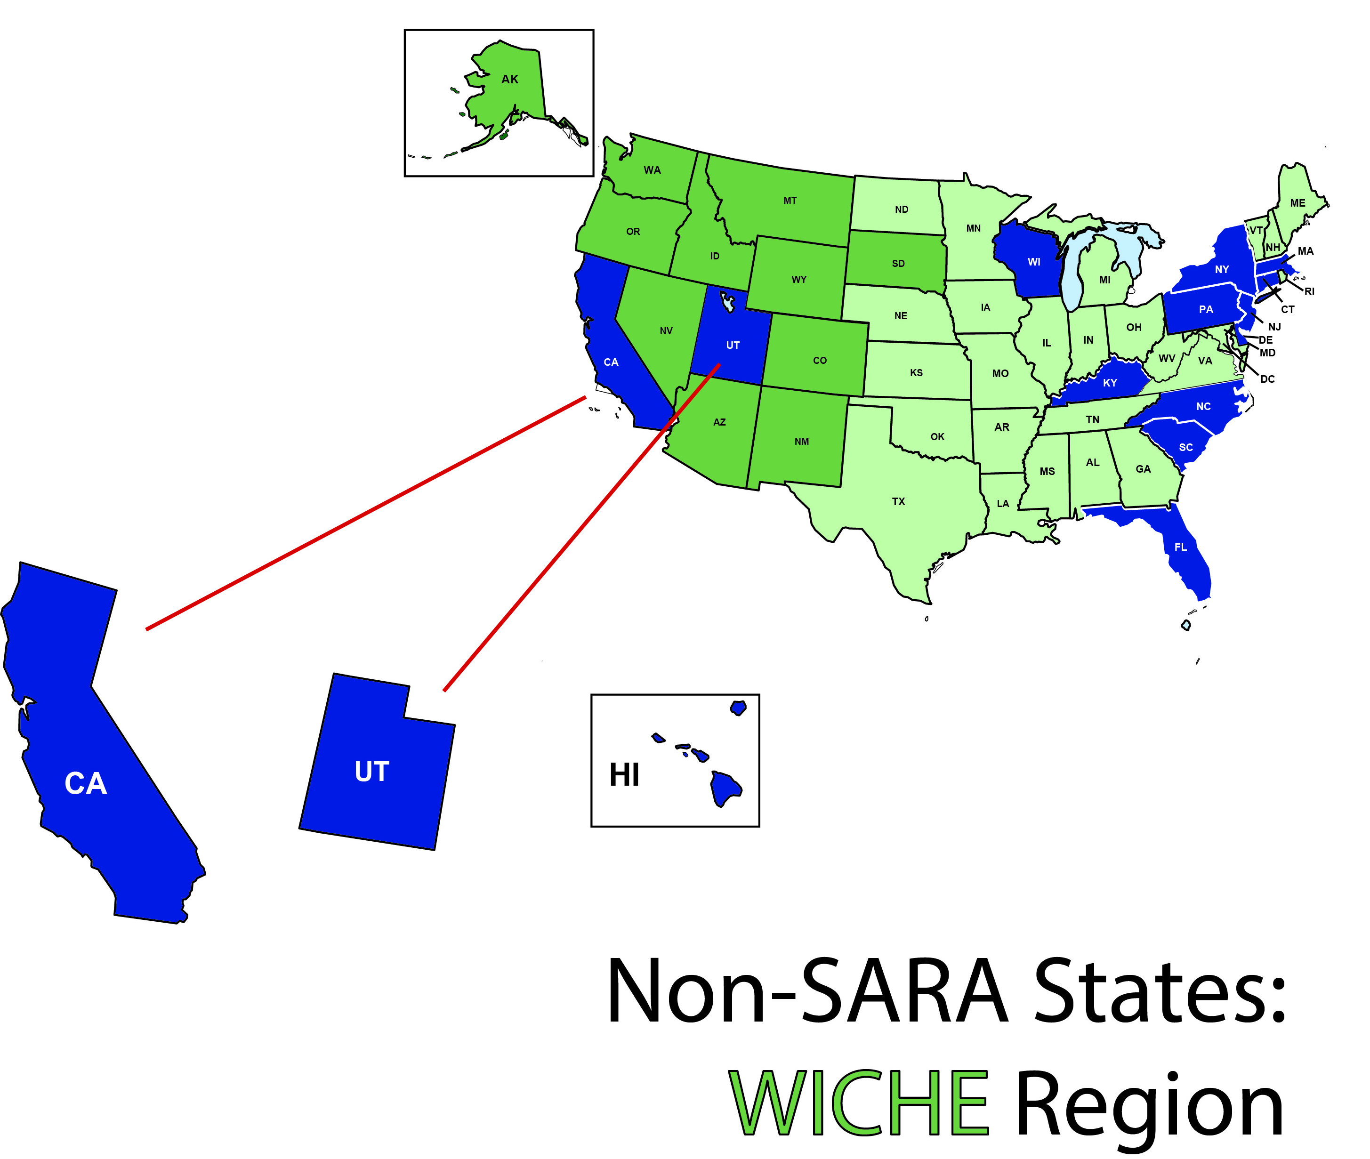
A Closer Look: WICHE

Slide 5
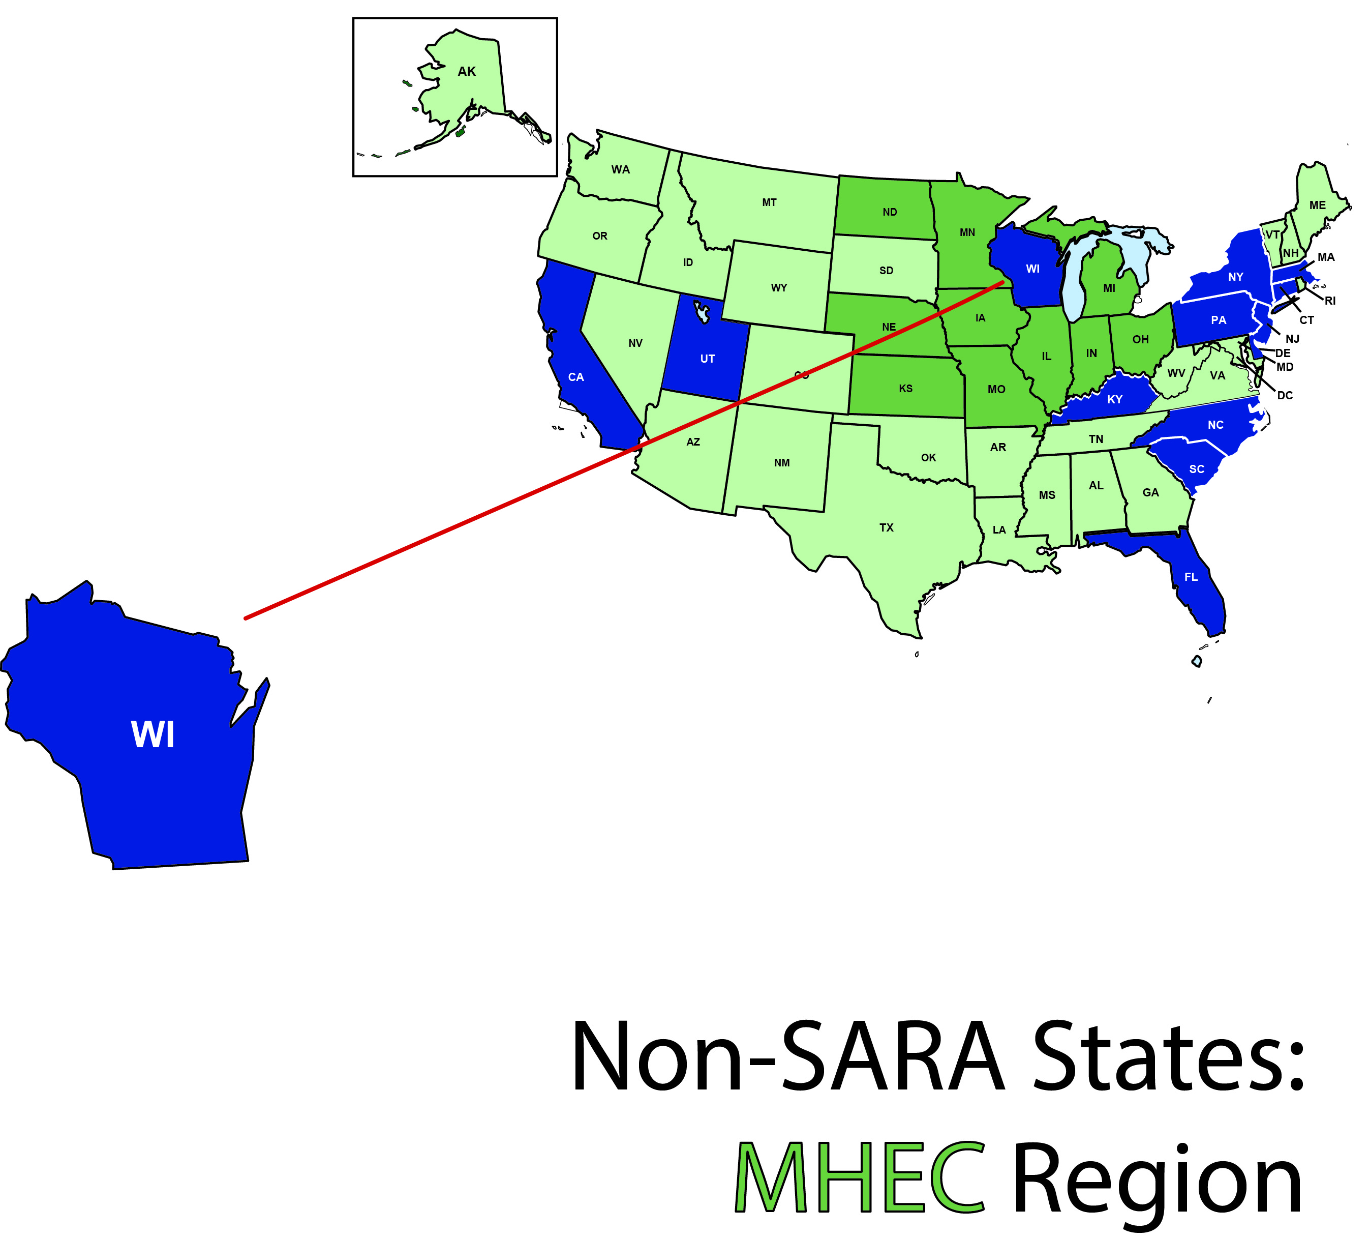
A Closer Look: MHEC

Slide 6
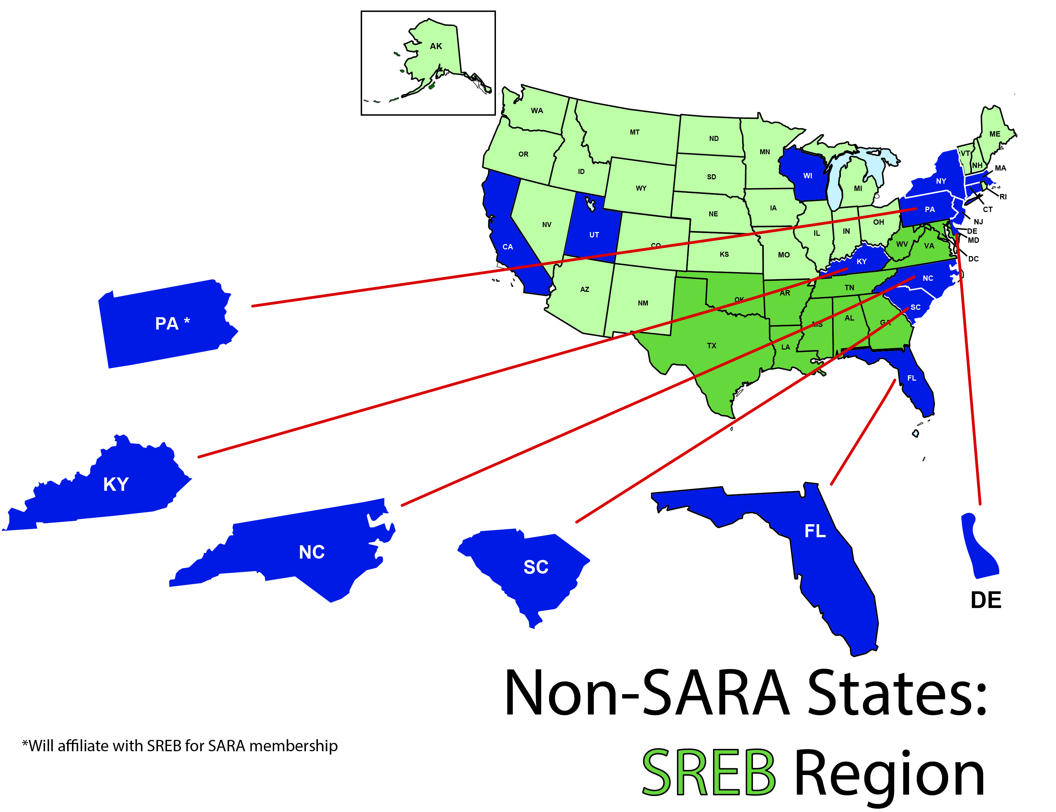
A Closer Look: SREB
*Plans to affiliate with SREB for SARA membership

Slide 7
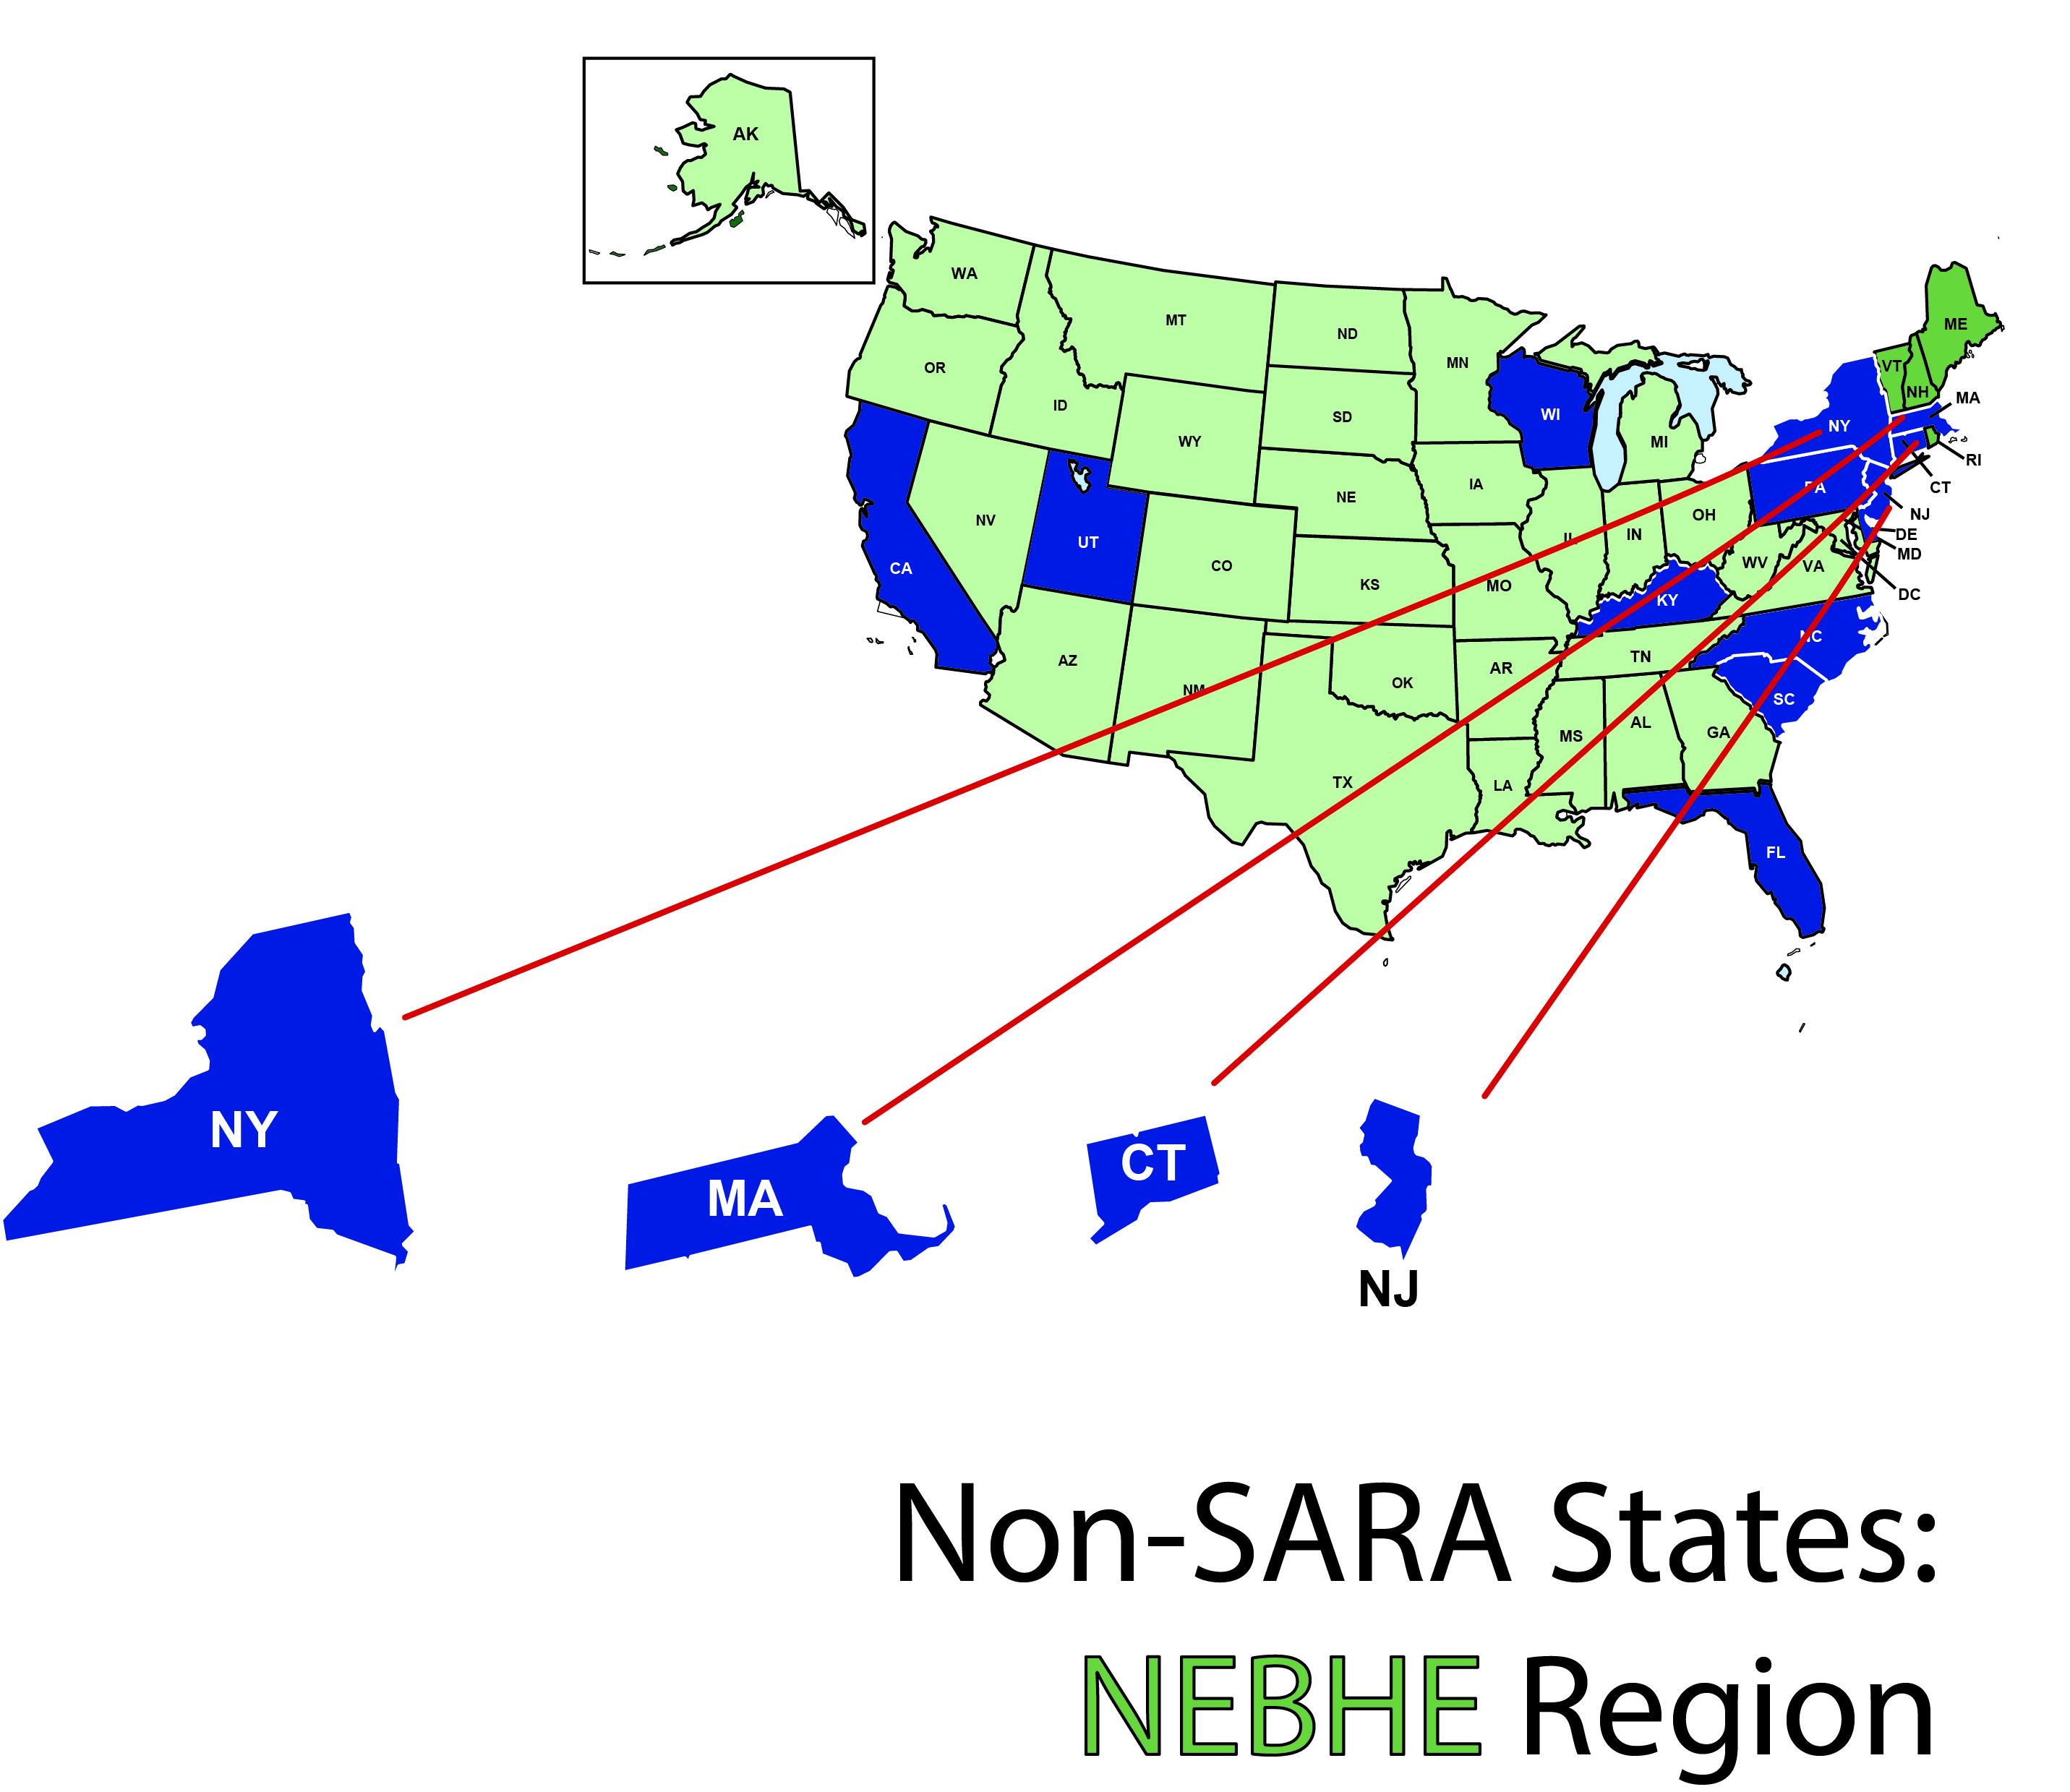
A Closer Look: NEBHE

Slide 8
A Closer Look: Districts and Territories

Slide 9
SARA Member States

Slide 10
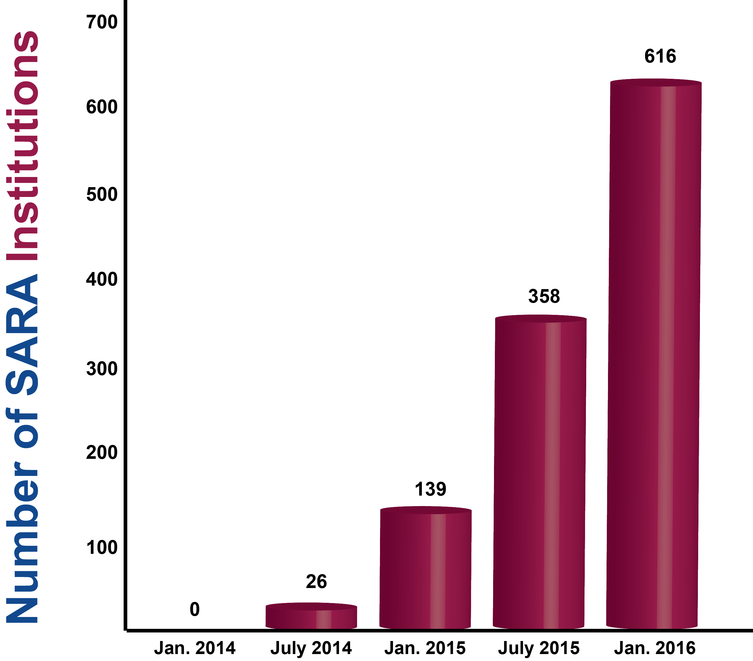
Participating Institutions

Slide 11
Participating Institutions
As of December 31, 2015

Slide 12
Participating Institutions
As of December 31, 2015

Slide 13
Financial Status of the Sara Initiative
SARA work by all SARA partners (NC-SARA, MHEC, NEBHE, SREB and WICHE) is now almost fully dependent on fee revenue
Current and projected revenues are sufficient to support SARA
Consequently, NC-SARA has determined to keep fees at current levels through June, 2018

Slide 14
What’s Ahead for SARA?
Complaint and enrollment reporting and publication:
Continuation of complaint reporting every quarter;
SARA institutions will report their out-of-state enrollments in May, 2016, with publication shortly thereafter;
Planned - Database of programs offered by SARA institutions
NC-SARA’s version of SREB’s Electronic Campus (NOTE: closes 6/30/17)

Slide 15
Now That We’re Past the “Easy” Stuff…
Continue to add states and institutions
Implications and implementation of IRS 501 (c)(3) status for NC-SARA
Establish independent budgeting, accounting, auditing and IT systems
Establish appropriate staffing levels
Responding to “down-in-the-weeds” questions and policy issues
Physical presence
Experiential learning
Etc., etc., etc.

Slide 16
Questions?
As always, feel free to contact information@nc-sara.org with any additional questions or comments

